Slide 1
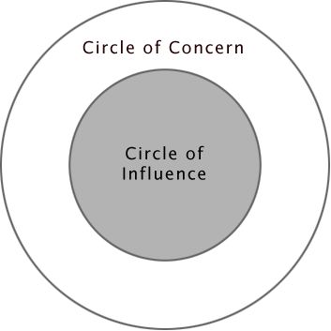
Focus on what you CAN do TOMORROW
(not what you can’t)
Stephen Covey: The 7 Habits of Highly Effective People (1989)

Slide 2
Focus on what you CAN do
(not what you can’t)
Notes:
Choose your response- what you say, how you behave, what you feel. Act consciously.

Slide 3
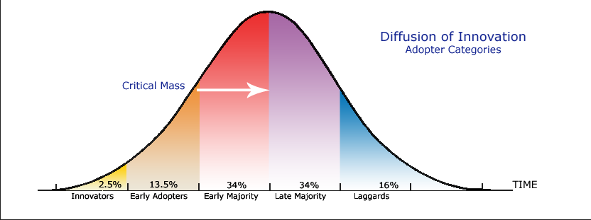
Find enthusiasts!
Rogers, E. M. (2003). Diffusion of innovations. New York, Free Press.
Notes:
There’s no point targeting the late adopters as they will only do this once 50% of your population has already done so.
Can you think of any examples? Eg telephone, television, car ownership

Slide 4
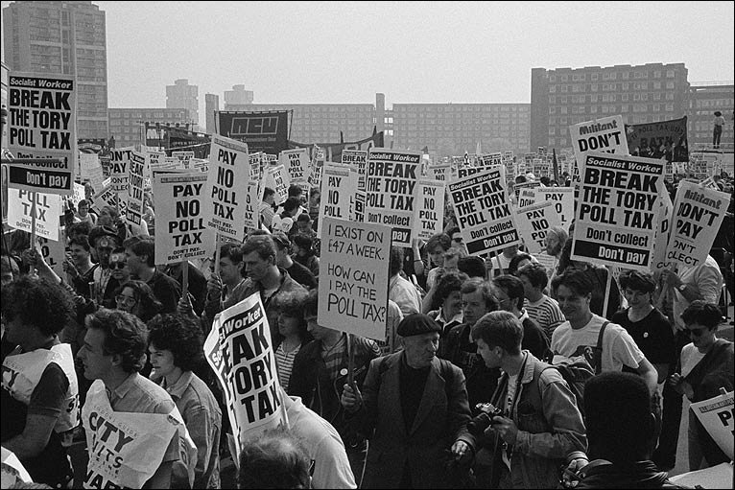
Start your test with 1 or 2 people
Don’t start with a large pilot….

Slide 5
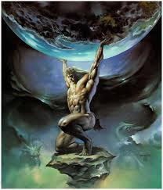
Don’t try and get one person to do it all!
Diverse skills work best!
Notes:
Don’t be afraid to ask for help- you can’t do this all on your own.
You need more than vigilance & hard work.
Ask for all the help and support you need from possible contacts, bringing together people with a mix of skills, knowledge and capabilities. You can keep adding to the team.

Slide 6
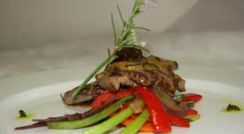
How do you create a signature dish…?

Slide 7
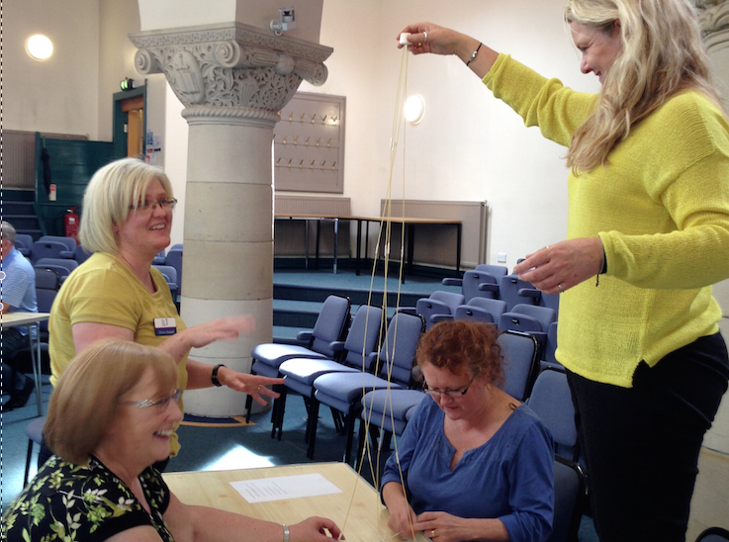
Lessons from the marshmallow challenge!
Notes:
Picture of marshmallow challenge
Also beware of hidden assumptions!

Slide 8
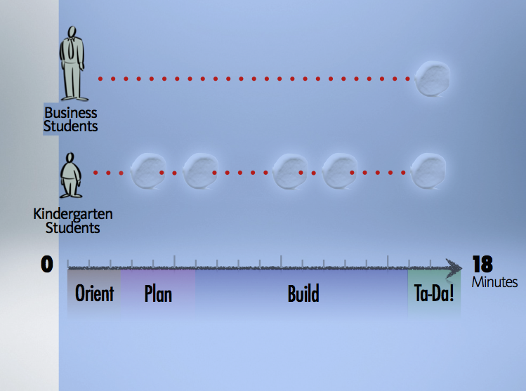
Prototype
!This provides more learning & best results

Slide 9
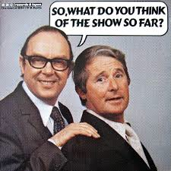

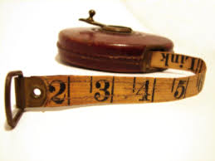
Measure your ‘improvement’ to find out if it has been successful!
Use simple measures to see if your test has ‘worked’
Get speedy results from your test & share straight afterwards to learn from it
Repeat, Repeat - paying attention to what it was that made it work & HOW to improve each test
We want to make it reliable.

Slide 10
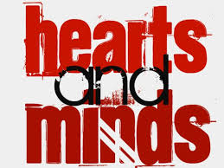
“Strong evidence for an innovation is necessary but not sufficient to result in its adoption.”
Mark Freeman, 2012. The International Journal of Management Education
Notes:
Anesthesia compared with antiseptics…
The first demo of anesthesia was in 1846. The by Boston surgeon, Henry Jacob Bigelow, was approached by a dentist called William Morton, who insisted he had found a gas to make patients unaware of any pain. This was a major claim as in those days, even a minor tooth extraction was excruciating. Without effective pain control, surgeons had learnt to work at speed and attendants pinned patients down as they screamed and thrashed about before they fainted from the pain!
Bigelow agreed to let Morton demonstrate on a young man who was to have a tumour removed from his jaw. Miraculously, the patient only muttered to himself in a semi-conscious state. The following day the as was tried out on a woman having surgey to cut out a tumor from her arm- she was silent and motionless.
4 weeks later, Bigelow published a report on the discovery. The idea spread like wildfire- travelling through letters, meetings and periodicals.
It was demonstrated in October, by mid-Dec it was being used by surgeons in Paris and London and by Feb, anaesthesia had been used in almost all the capitals of Europe and by June, in most regions of the world. Within 7 years virtually every hospital in America and Britain had adopted the new discovery.
There were some forces of resistance – some criticized it as a ‘needless luxury’, while older surgeons saw pain as a necessary evil while clergymen said using it to reduce the pain of childbirth was frustrating God’s design.
Compare this with sepsis or infection – the single biggest killer of surgical patients (claiming about a half undergoing major operations). Pus from a wound was also thought a necessary part of healing.
In the 1860s, the Edinburgh surgeon, Joseph Lister read a paper by Louis Pasteur proposing that spoiling and fermentation were caused by microorganisams. Lister became convinced this also accounted for wound infection. During the next few years Lister perfected ways to use carbolic acid for cleaning hands and destroying germs. The result was a sig lower rate of sepsis and death.
Like Bigelow, he published a paper in The Lancet on his results- but unlike the use of anesthetics, antiseptics did not spread like wildfire.
Surgeons soaked their instruments in carbolic acid, but their coats remained caked in blood and they re0used sponges without sterilisig them. It took a generation.
Why?
Both required attention to detail) – whether this was what and how you soaked hands/instruments or obtaining ether, constructing the inhaler and getting the dosage right (or you killed people).
Both had positive impacts on patients- leaving them alive to pay their bills
Germ theory seemed illogical- but so was the idea that if you inhaled gas you could enter a pain free state.
Both encouraged patients to try it themselves to see the results.
The difference:
One combatted a visible and immediate problem (pain)/the other combatted an invisible problem (germs) – whose effects couldn’t be known until after the operation.
Both made life better for patients, but only anesthesia made life better for doctors, changing surgery from something that was brutal and time-pressured on a screaming patients to a quiet and considered procedure. In contrast, Lister’s invention required doctors to work in a shower of carbolic acid resulting in burnt hands ie. personal sacrifice. (It was a harder sell).

Slide 11

Spreading the improvement
Notes:
Share your stories (good and bad)- mass media can introduce a new idea to people, but people follow the lead of other people they know and trust. (After resistance to take up, sugar/salt solutions to save lives from cholera/diarrhea, was achieved in Bangladesh by literally going door to door as part of a campaign, with workers discussing what worked/didn’t each night after dinner. This included teaching people how to make up the exact recipe themselves using finger measures – with villager able to ask questions in their own words and be guided and observed. Quality of teaching suffered if workers tried to teach too many mothers a day. ). The decision to make that effort is a social process.
Find new leaders- don’t expect the original improvement team to do it all. Plus, they may be great improvers, but not in a position to lead others.
Let them do their own tests – ward 5 may be different from ward 4.
Mage of door to door salesman? (But negative connotations- get them to reflect on what a good salesman does/is – using images?)

