Slide 1
Vivien Moffat, IRISS Social Isolation & Loneliness Conference, Inveraray 2 December 2014
Preventing social isolation
and loneliness in older people
Notes:
*

Slide 2
Today’s presentation
Overview of IRISS – who we are and what we do
Plan P
What does the evidence tell us?
Contact/information

Slide 3
IRISS is a third sector organisation promoting positive outcomes for the people supported by Scotland’s social services

Slide 4
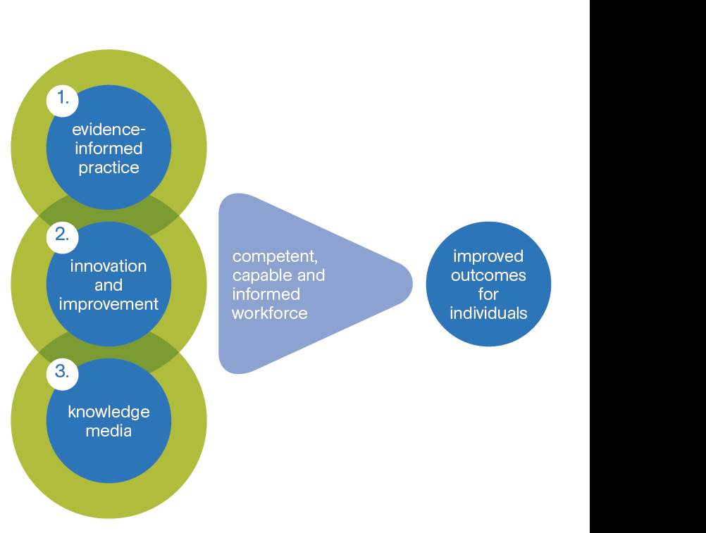
We focus on three key areas…
*
Notes:
Our three programmes of work, how they contribute to the ultimate outcome….

Slide 5
Improved understanding about prevention of loneliness and isolation for older people
Scalable blueprints for local interventions
Older people and communities are involved
Making a difference

Slide 6
Plan P activities
Advisory Group
Review Evidence
Prompt cards
Communication

Slide 7
Plan P activities
Case Studies
Trying new ideas
Building on the evidence
Communication

Slide 8
Evidence

Slide 9
Loneliness and social isolation …life changes
Physical and mental health deterioration
Caring responsibilities
Bereavement
Dementia
Retirement
Social networks diminish
Notes:
Older people may be widowed after many years of partnership, may lose sight or hearing or physical ability to get out in the community, may become a carer and not be able to leave the cared for person, may find themselves moved to a care home away from their own community, may lose confidence, may develop dementia, for BME groups may begin to lose english language

Slide 10
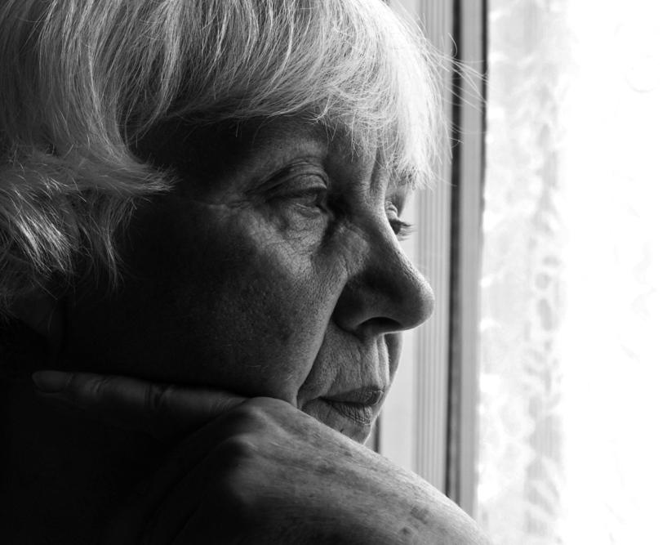
10% of over 65s are lonely

Slide 11
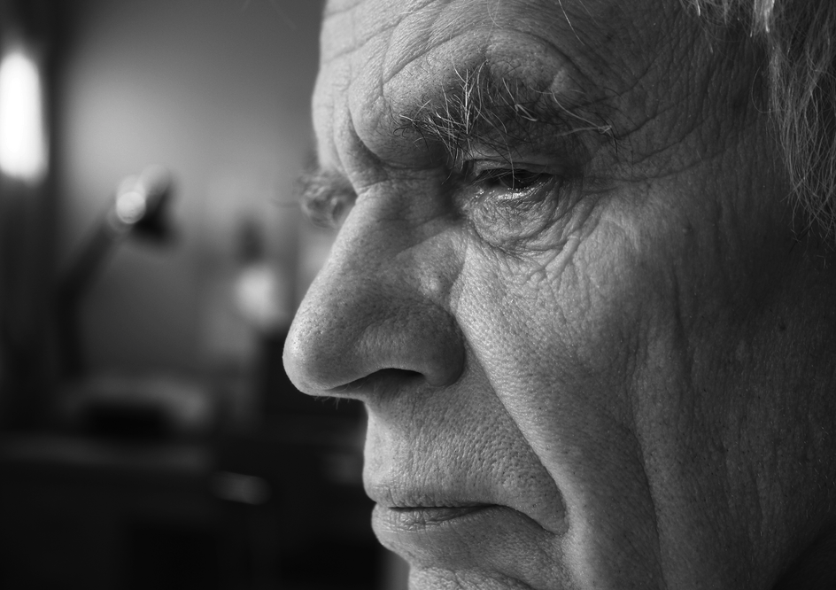
50% of over 80s are lonely

Slide 12
Poorer health and wellbeing
Anxiety/ depression/stress
Heart disease/ High blood pressure
Increased risk of dementia
Increased alcohol or tobacco use
Poor diet/nutrition
Reduced exercise
Increased visit to GP / medication/treatment
Increased admission to hospital or care home
Notes:
There are strong links with poorer physical and mental health and well being for people who are lonely and isolated.
Heart disease, mental health issues – depression, anxiety, stress,
Poor sleep
This may be linked to increased levels of alcohol or tobacco use, poor eating habits, lack of exercise
As well as depression and anxiety

Slide 13
15 Cigarettes a day?
15 Cigarettes a day?
Notes:
Or image of a cigarette or of people smoking
A meta-analysis of studies 1900 – 2007 showed significantly greater risk of mortality 50%
The detrimental effects of loneliness and social isolation have been compared with the smoking 15 cigarettes a day.
Health Scotland presentation – we need more evidence but we have enough to act now
Also has a greater effect on mortality than obesity, alcohol or sedentary lifestyle
As well as being not what we want for our society, our own families or for ourselves, it also represents a cost in terms of increased health care needs and admission to hospital or residential care.

Slide 14
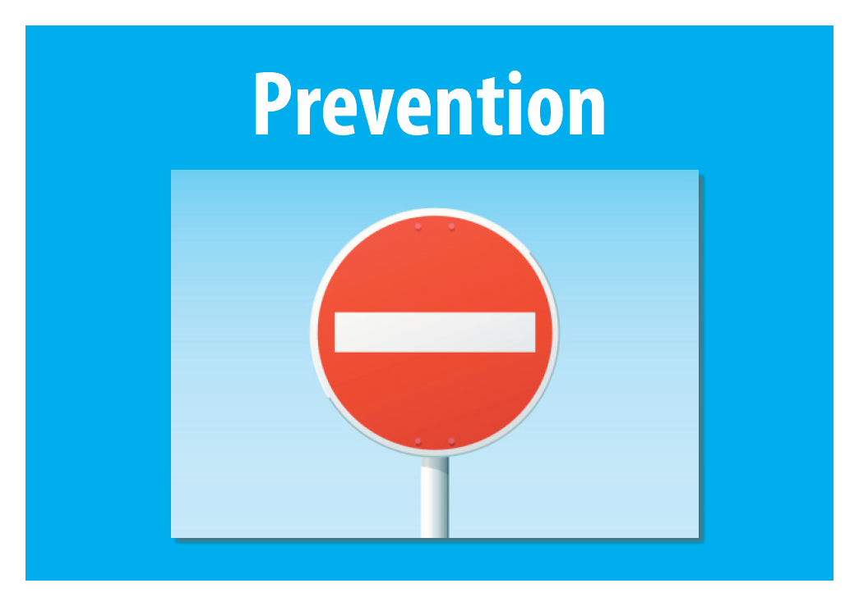
Notes:
Prevention often used to describe reactive interventions to support older people who are lonely and isolated. Perhaps we need to really shift focus to building the kind of communities where people are better connected to their friends, family and neighbours, where older people are valued as active citizens.
Do we need work towards both universal and targetted interventions?

Slide 15
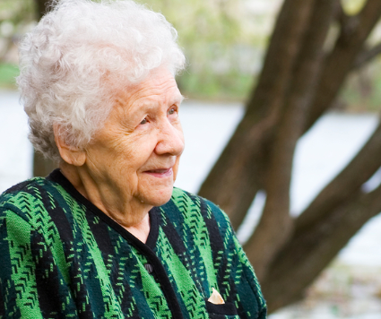
Being happy and healthy and having respect
Notes:
Universal prevention
Community involvement
Co-production
trying to provide some additional evidence which will encourage investors, and investors, I mean not just the public sector, but the private sector and the third sector, to see that it is perfectly legitimate to invest in preventative approaches,
I am hoping that the project will actually start to identify that there is value to health services in investing, if you like, upstream in services which actually address these issues at their core, rather than wait for a deterioration in individuals, such that we have to respond in a different and less co-productive way.
Now the local doctor had known about this men’s cooking group and rather than just giving him anti-depressants, he suggested he came there. So he was very successfully learning how to cook, but not only that, he was linking with the other men in this village and going to different ... he was telling us about all the different events he was going to, so I think there’s a really good intervention by the doctor by re-engaging him with the community.
We need to look at society as a whole, we need to look at intergenerational groups and we need to look at how we actually integrate all of society and recognise that we all have something to give from the youngest to the oldest.
what a community that absolutely has prevention embedded in it looks like, for me in terms of the touch and feel at the very essence of it is people know who each other are, because prevention is about connections
that conversation remains to take place between government and society about what their expectations are and government then needs to support public sector organisations and society move to a position where it’s about how we actually facilitate our own healthcare and our own wellbeing, being supported by organisations, not just in the public sector but the third sector as well. And I think that once that conversation and once that recognition takes place that we do need to shift the way we actually see how we support ourselves and how public services and the third sector can help us, support us, facilitate that, rather than do it for us,

Slide 16
Who needs to be involved?
Services
Commissioners/budget holders
Families
Communities
Older people
Notes:
Who needs to be involved –not just services any more - the community and older people themselves are a significant part of the solution – asset based approach
People must work together – co-production
We looked at evidence of the most effective interventions – from systematic reviews/meta-analyses

Slide 17
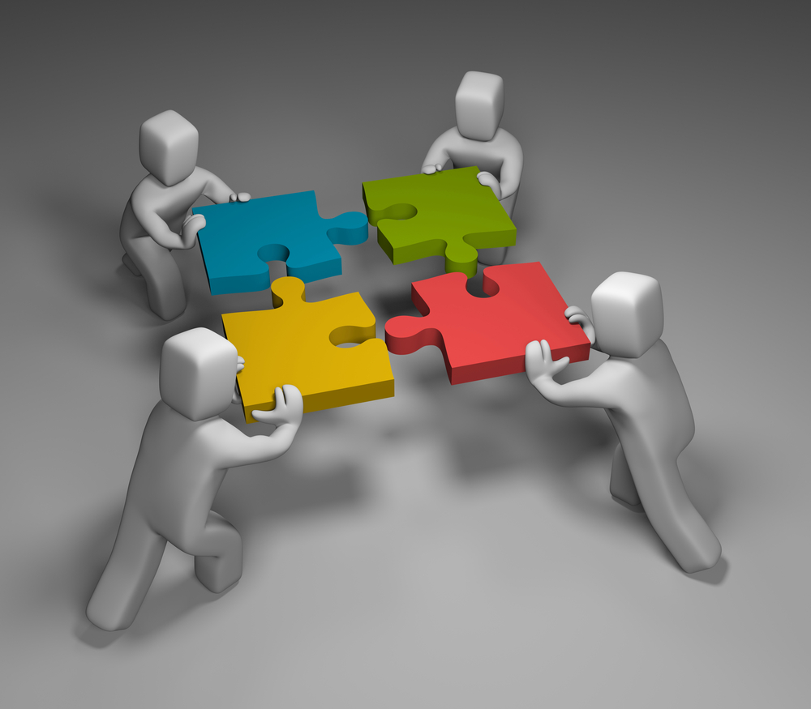
Evidence tells us older people
need to be partners

Slide 18
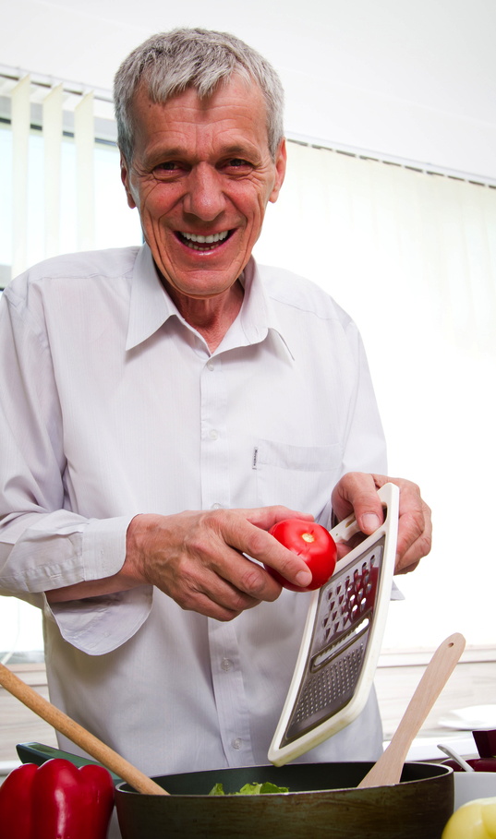
Interventions tailored to the individual
Notes:
Being flexible and adaptable to needs
Raising awareness

Slide 19
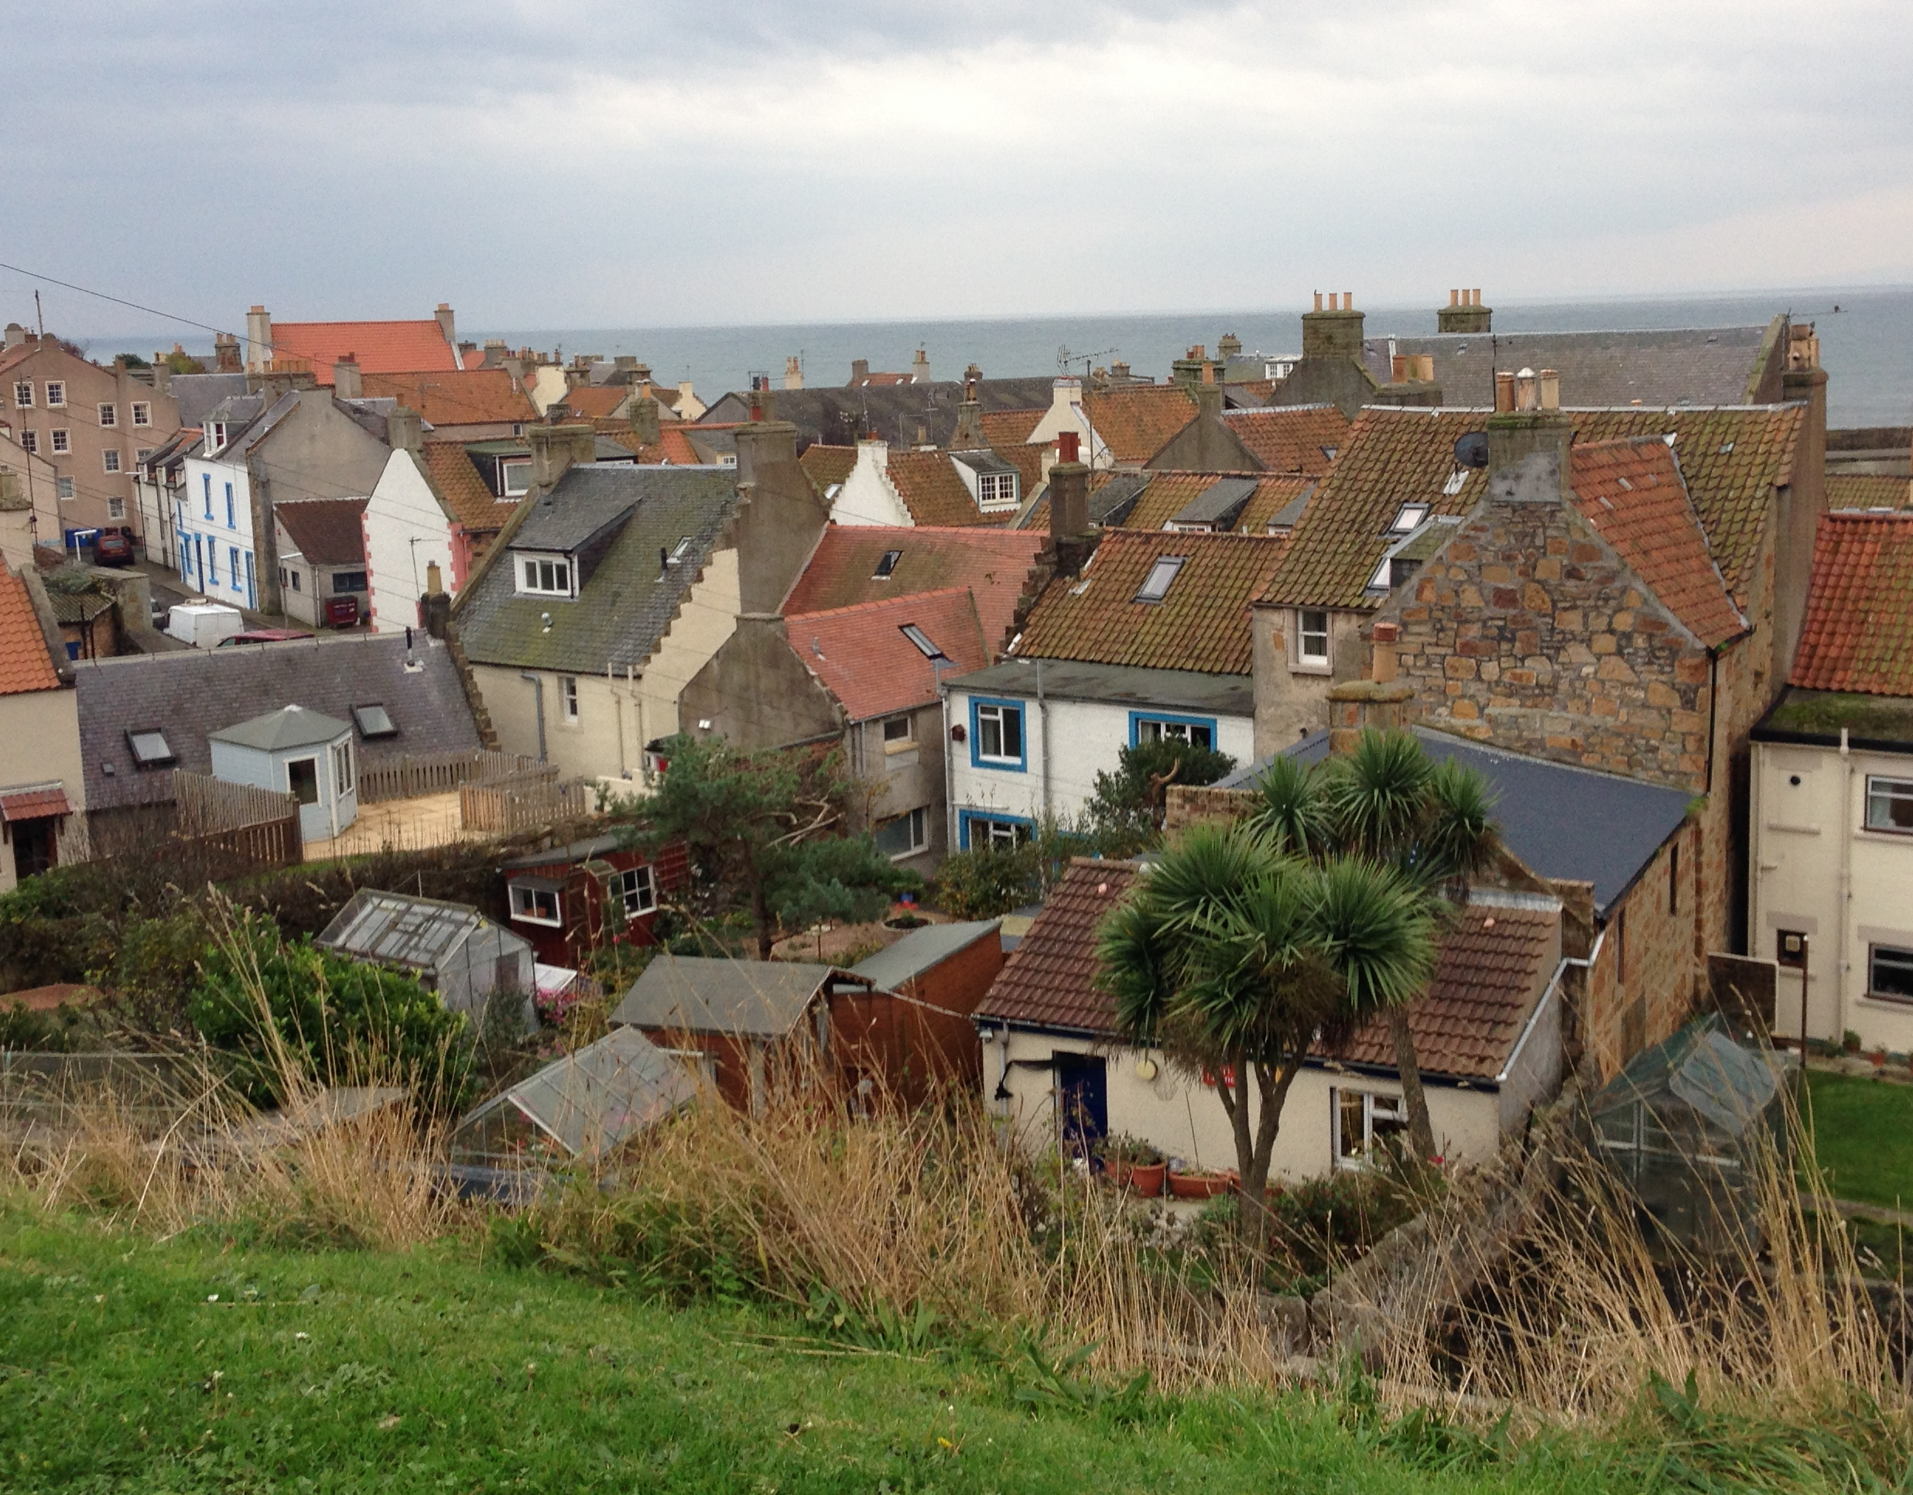
Building strong communities
Universal approaches
Connections
Co-production
Resilience
Notes:
Raising awareness – building strong and resilient and connected communities
Universal prevention

Slide 20
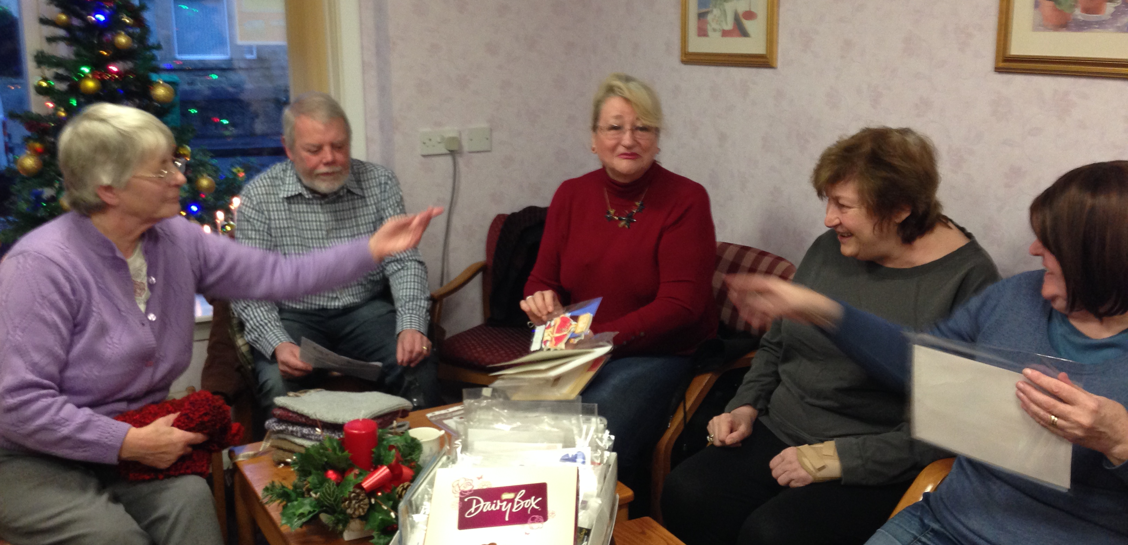
Valuing older people
as assets

Slide 21
Being needed makes me feel great

Slide 22
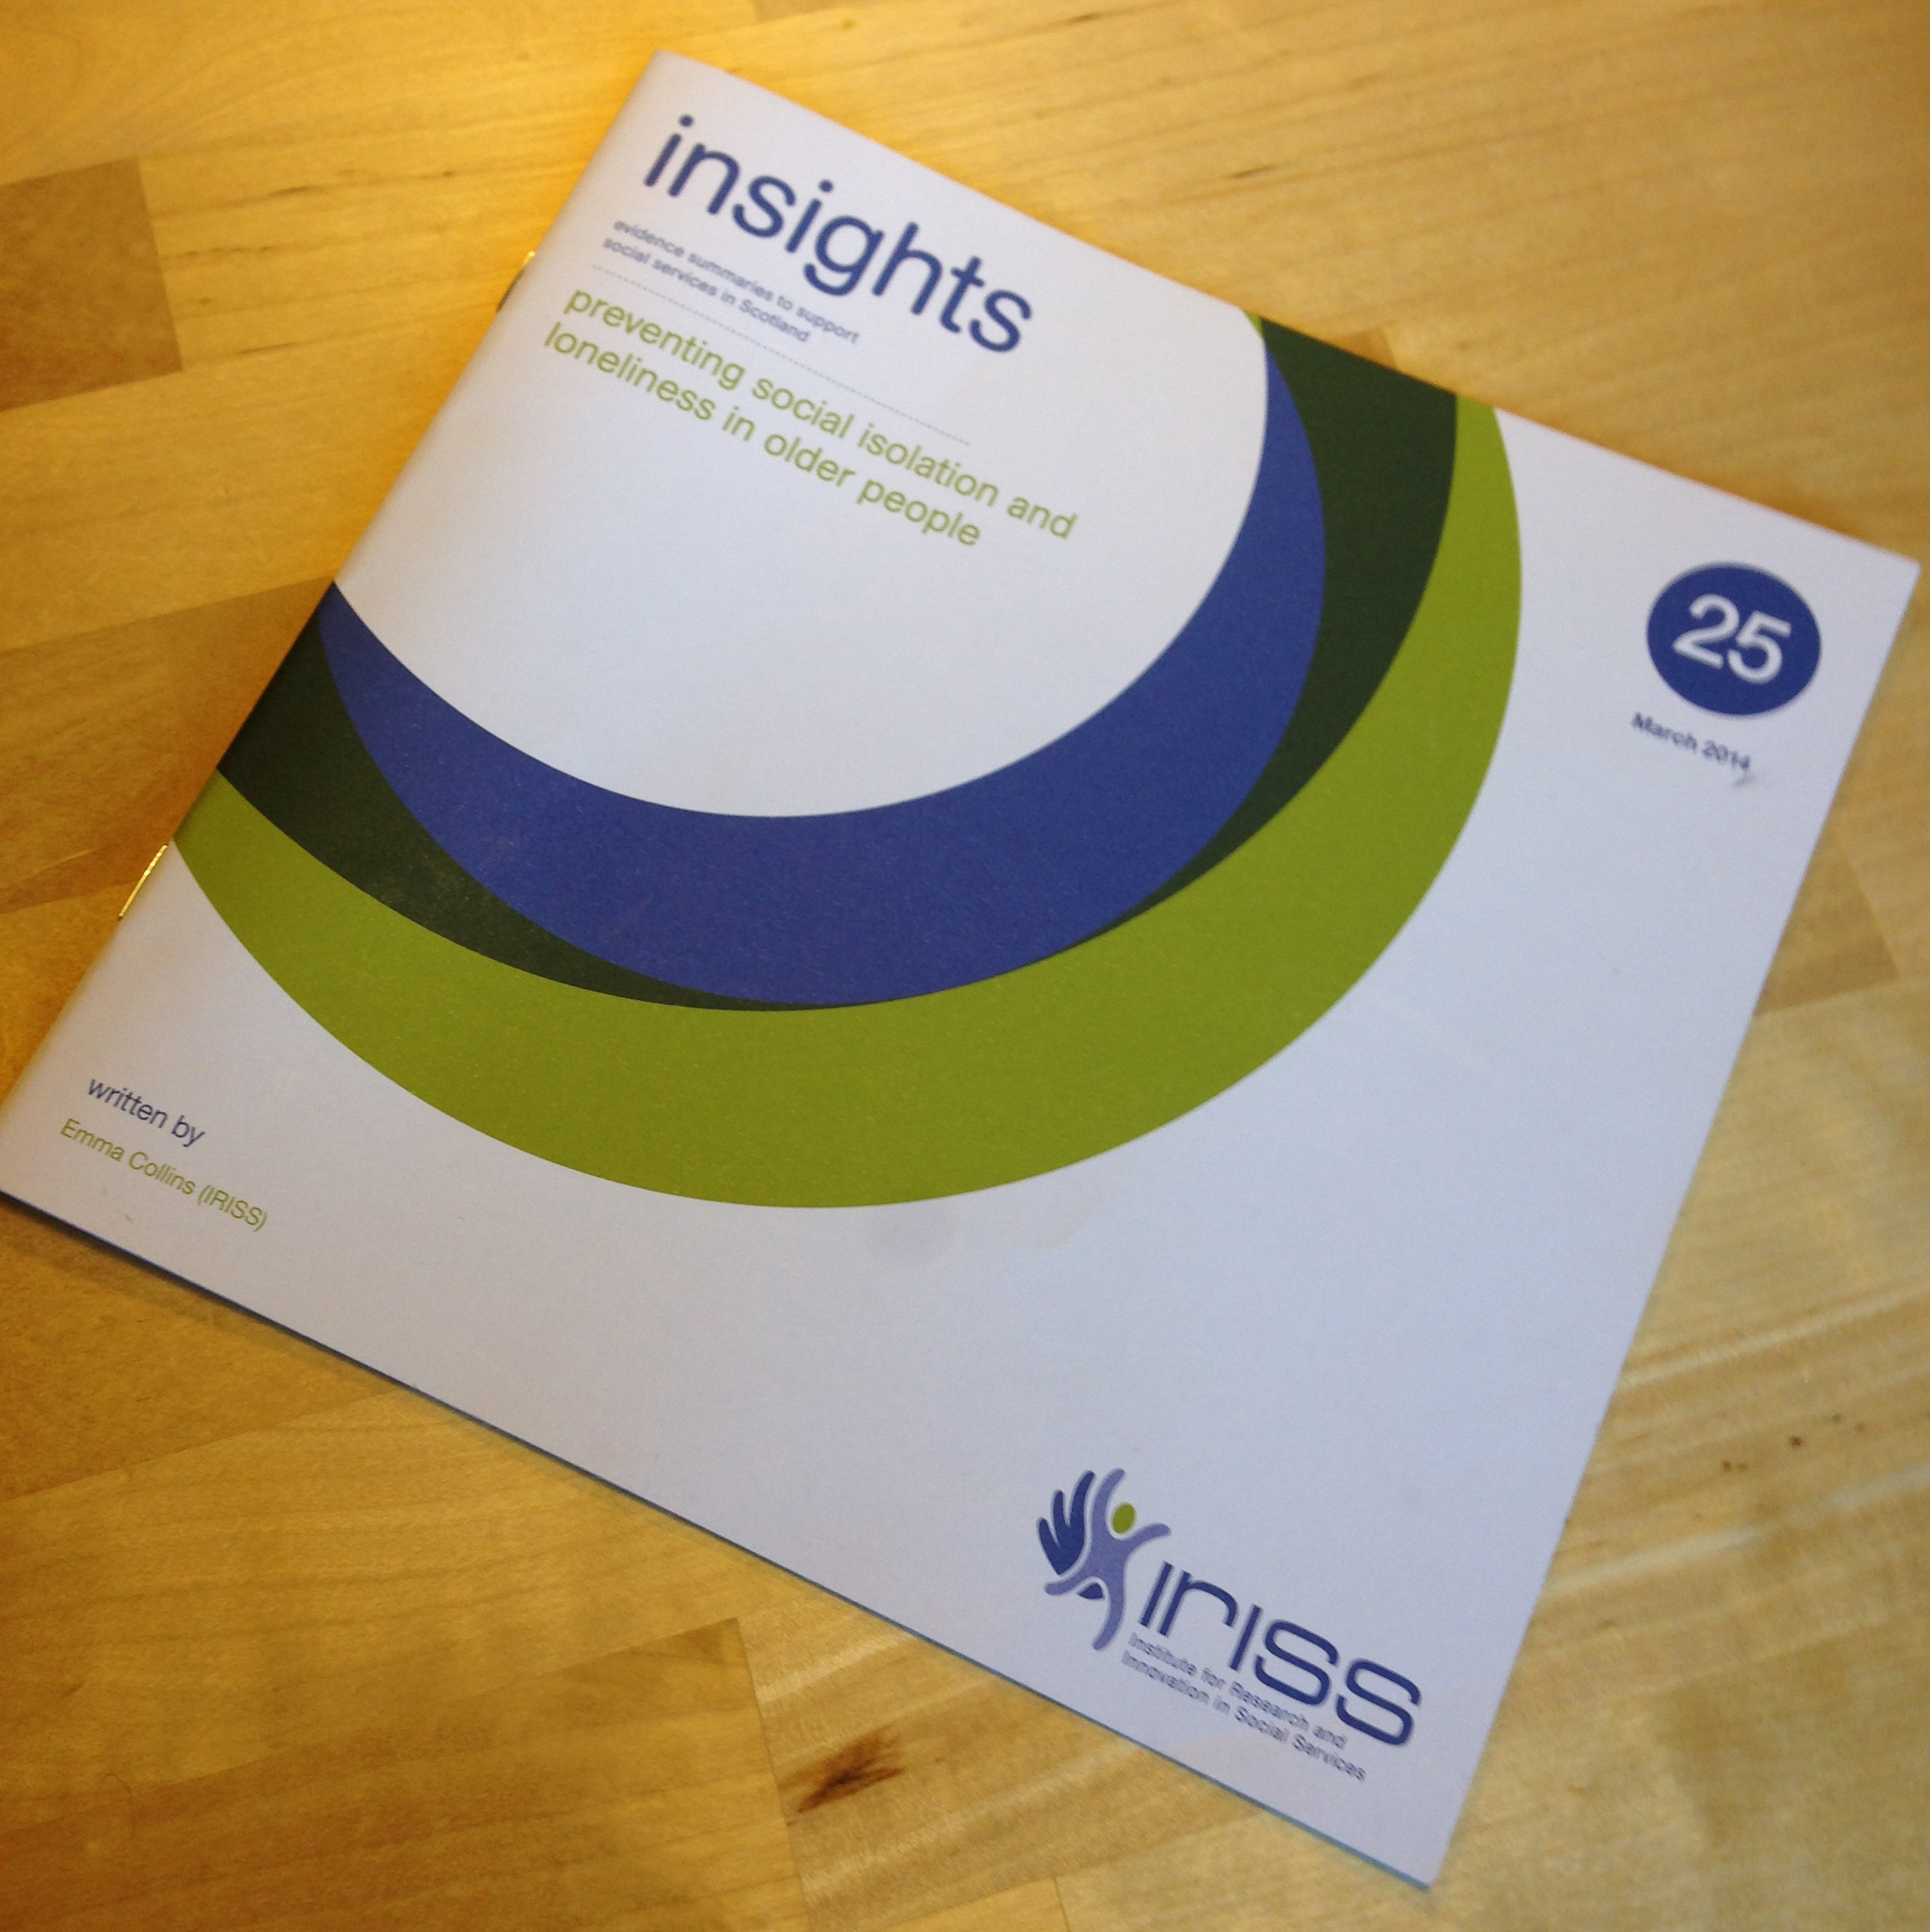
Key Messages from the evidence

Slide 23
Effective approaches
Older people are active participants
Older people involved in planning and implementation
Support is flexible and adaptable to needs
Group activities
Community based
Notes:
Types of intervention with less evidence.
One-to-one interventions – want a supporter ‘like’ themselves
technology

Slide 24
Implications for practice
Be aware of the issue
Be aware of local supports/share info
Involve older people
Be adaptable/respect differences
Enhance independence rather than provide a service
Workforce development
Share learning
Notes:
Depression – indicator for loneliness
Widowhood – associated with loneliness
3 barriers:
Info
Transport
confidence

Slide 25
Contact and info
Website - http://www.iriss.org.uk
News - http://www.iriss.org.uk/mailing-list
Plan P website - http://blogs.iriss.org.uk/planp/
Vivien.moffat@iriss.org.uk / 0141 559 5060

