Slide 1
The Attitudes of Elderly Patients and their Relatives to being Boarded from Acute Medical Assessment at the Edinburgh Royal Infirmary. Amy Begg Staff Nurse, Royal Infirmary

Slide 2
What is a Boarder?
The National Health Service (NHS) definition of a boarder “is a patient who occupies a borrowed bed”. That is a patient that is cared for in another ward or area of the hospital, other than the ward of the consultant or consultant team, that are caring for them.

Slide 3
Research Questions:
What are the attitudes of elderly patients towards being boarded within the hospital?
What are the attitudes of elderly patient’s relatives to their family member being boarded within the hospital?
What ways do elderly patients and their relatives think we can improve on this service?

Slide 4
Who did I Survey?
I surveyed 11 patients who:
Were over the age of 70.
Who remained in the boarding ward for at least 24 hours.
Who had an AMT (abbreviated mental test score) of 7 or above.
I sent relatives of those 11 patients questionnaires, receiving 4 completed questionnaires back from relatives.

Slide 5
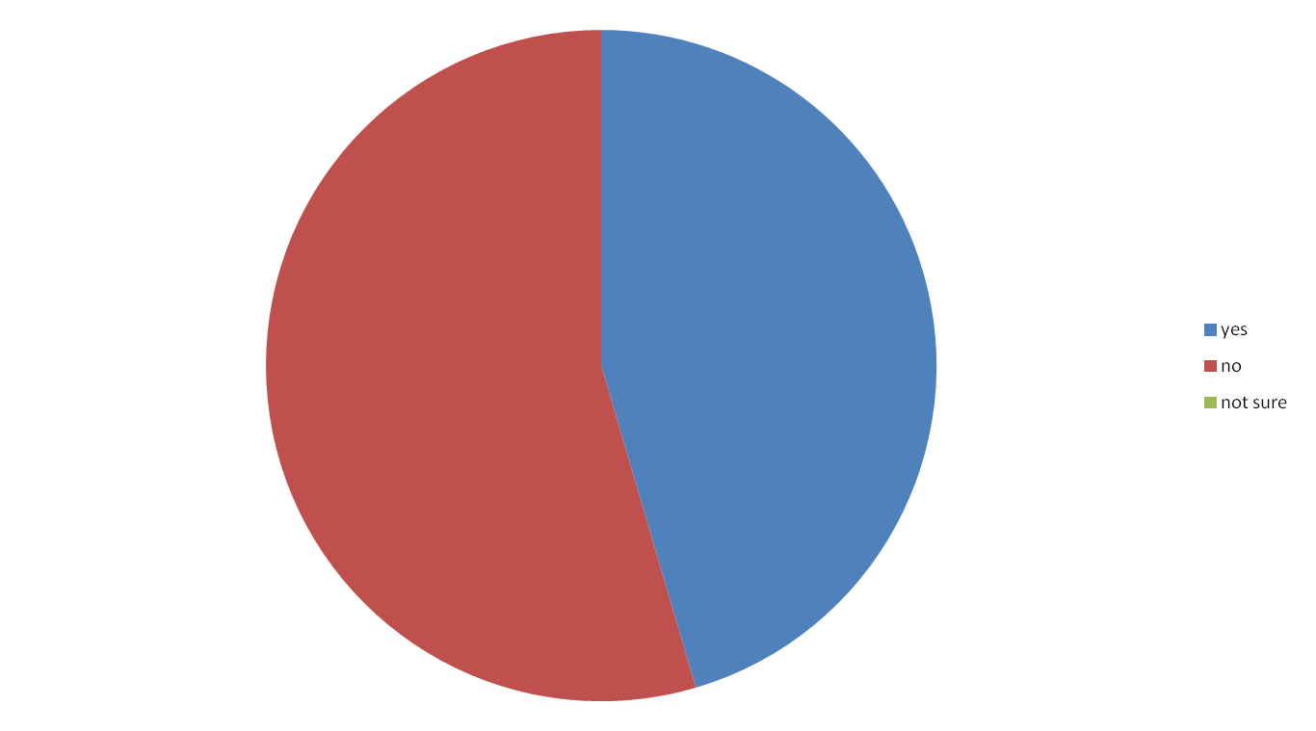
Results of the Survey. Just under 50% of patients were made aware of the possibility of being boarded.
Notes:
It is important that all patients and relatives are made aware of the possibility of being boardered.

Slide 6
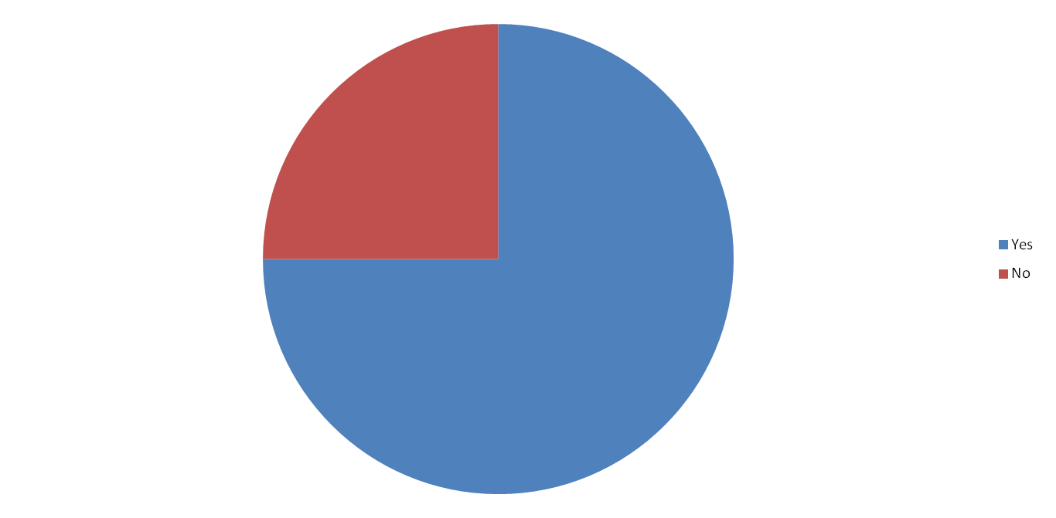
75% of Relatives were made aware of the possibility of their relative being boarded.

Slide 7
How Patients felt about being boarded.
What am I up here for?
Very comfortable with it.
Didn’t mind at all.
Feel Safe.
Know your in the right place.
Happy felt I was being given more investigation.
Didn’t make any difference.
Didn’t know I was being boarded. Now I have had it explained I understand it more.
No choice.

Slide 8
How Relatives felt about their family member being boarded.
She was moved because they needed the bed
My only concern was for their comfort and he was perfectly happy.
Having had it explained that my father‘s condition would best be treated on another ward, either medical or orthopaedic – I was reassured about this.

Slide 9
How did patients feel up on the new ward?
Alright, didn’t bother me.
It was quieter,
warmer.
Happy.
Fine.
Welcomed.
What am I up here for?
Was trying to sleep and deal with the pain.

Slide 10
100% of relatives felt that their family member being boarded didn’t affect their care.
82% of patients didn’t feel that being boarded had any influence on their care and or treatment.
100% of relatives felt they had access to information regarding their family member either from doctors or nurses.

Slide 11
Ways in which patients and relatives feel we could improve on this situation.
More organised.
More staff.
Informing family.
Moved while still awake.
Correct information given to patient and relatives. Ensure patients and relatives are kept informed and there is no conflicting advice.

Slide 12
Summary
While we were good at informing relatives that the patient could be boarded, we could improve on the information given to patients regarding boarding.
Elderly patients and their relatives didn’t appear concerned about being boarded in another ward.
Relatives felt they had access to patient information.
Notes:
So far I have found that elderly patient s don’t seem to mind being bordered they are just gratefully to be being cared for. They seem to appreciate that the hospital is busy and that being bordered is part of the hospital journey.

Slide 13
Obstacles
Elderly patients had a lack of understanding of their patient journey while in hospital.
Change of name from Combined Assessment Unit, to Acute Admission Unit.
The change of assessment tool used to assess confusion and delirium.
Time constraints.
Lack of response from relatives questionnaire, only four having been completed.
Notes:
When asking the questions I found that a lot the elderly patients got confused between A&E and AMU and being boarding up to a ward.
This seems as a simple change but understandably it can be confusing to patients and relatives when staff and myself as a researcher use different names to described the ward
This change let to me having to adjust my crieria

Slide 14
Scope for future research
What are Staff Nurses opinion of elderly patients being boarded?
Identify what Staff Nurses feel are obstacles faced while transferring and caring for these patients, both on the boarding ward and the transfer ward.
What do elderly patients feel about the whole hospital journey, what are their worries and concerns while they are in hospital.
Notes:
Although this research project has only sampled a very small number of elderly patients, it has identified areas to reseach more indepth.
It would be interesting to look at the staff nurses opion to elderly patients being boardered and identy what they feel are opsitacles they face why transfering and caring for these patients. Nurses are the medical proffessional that has the most contact with both patients and relatives.
I would also be interesting to look into how elderly patients feel about the whole hospital journey and what there worries and concerns are while in hospital.
Nurses are the medical proffessional that has the most contact with both patients and relatives, and often have to deal with both the positive and negative feed back reguading patients

Slide 15
Conclusion.
By developing and carrying out this research project I have:
gained knowledge on the attitudes of elderly patient to being boarded.
I have also gained a better understanding of the research process, allowing me to be better equipped as a researcher in the future.

