Slide 1
Practitioner Research for Older People
Is Music the Best Medicine? : Using Prescribed Music to Enhance Quality of Life for People with Dementia and their Carer
Janice Caine: Service Manager
Practitioner Research Project For Older People With The University of Edinburgh

Slide 2
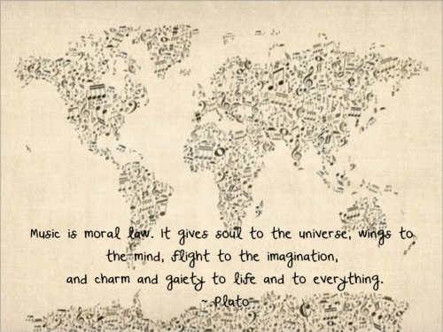
Why Research Music?
It is the capacity of music in maintaining a person's identity: reminding them of their life history and maintaining personhood that is important (Kitwood,1997)

Slide 3
Is Music the Best Medicine?
Using Prescribed Music to Enhance Quality of Life for People with Dementia and their Carer
If music enhances the lives of people with dementia..Can it also enhance the carer's life?
Is there a way that Carers can see another side of the person they care for- as we often do?
Is there a way to involve them?
Can I use this as a research question?

Slide 4
What Did I Do ?
Lots of Reading !
Lots of Planning!
Started to explore who might want to be involved?
Involve people in early to moderate stages of their dementia
Not use medicalised measurement tools!

Slide 5
My Design Aims
Design had to involve participants- To have meaning !
Qualitative in Design-their views !
Participative Action Research- hearing their voice !
Wanted to design feedback tool with participants- their words !
Participants would use MP3 players with headphones and listen to preferred Music- their choice !

Slide 6
Begin The Beguine
Discussion Group with people with dementia & group with carers
Designed Feedback form using emotional touchpoints
10 Semi structured interviews/ Diaries from carers
Transcribed discussion groups, semi structured interviews
Thematic & Narrative Analysis
Vignettes & Ipoems

Slide 7
Feedback Form

Slide 8
The Experience of people with Dementia
It makes you just relax.......I enjoyed it..... I love music... You were just gone...you can’t talk and listen;
It went well... I enjoyed the music... Relaxed and Peaceful; It does work... it was lovely, thanks
Yes and I actually did enjoy listening to it because I could sit up there with the headphones on and nobody could distract me...I think it was... I quite enjoyed it ... it was funny, cos I’d never worn headphones before.
I usually just listen and but I thought ... you’re getting it quite literally into your head aren’t you?
Yes, you can’t hear anything...

Slide 9
Experiences of Carers
Aye I got half an hours peace... She was relaxed and focused on a photograph of five generations of the family. It evoked vivid memories from long ago-memories of their wedding, first house sixty years ago.
Oh it’s positive as I can come down and not worry as I know she’s listening to her music and enjoying it ..Would like to continue doing this... I would encourage him to do it...it went really well.
I was a bit sorry when the 45 minutes were up and I thought ah well... It was nice to see her happy
Quite happy to listen... very settled and relaxed; She is away with the fairies... singing ,swaying with her eyes closed, fully engrossed;

Slide 10
Findings
Each person with dementia said that listening to music had made them more relaxed and happier.
All carers agreed it was a positive experience.
Using an MP3 player and headphones allowed people to focus on the music, cut out any distraction and appears to concentrate the effect
The carer got a break while the person with dementia listened to the music
In some cases, the positive effects lasted for a few hours
Listening to music for participants with dementia relies on their carer reminding them and often in assisting them with the player & headphones.
All carers felt the person with dementia would have listened longer if they had not been reminded to stop

Slide 11
Last Notes
Policy context- Delivering Integrated Care- Supporting Carers & Therapeutic interventions
Easily accessible
Non Intrusive- Low Cost
Spread the Word-

Slide 12
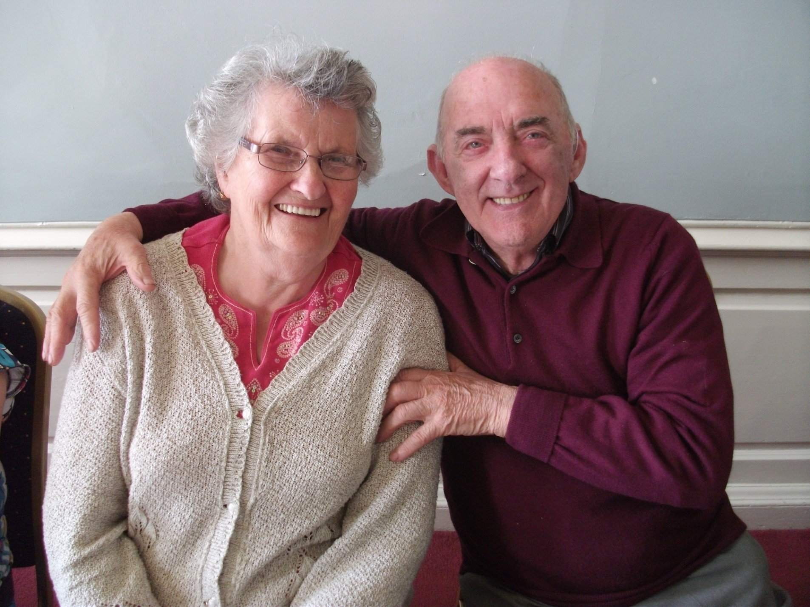
Last Thoughts

